Slide 1

Web Engineering – Basic HTML
J2EE
Lecture # 2

Slide 2
Overview
Basic HTML
More HTML Elements
Web Standards

Slide 3
Basic HTML

Slide 4
Hypertext Markup Language (HTML)
Describes the content and structure of information on a web page
Not the same as the presentation (appearance on screen)
Surrounds text content with opening and closing tags
Each tag's name is called an element
syntax: content
example: This is a paragraph

Slide 5
XHTML
Uses a markup format called XML
XML + HTML = XHTML
Standardized in 2000
A strict XHTML page uses some different syntax and tags than HTML

Slide 6
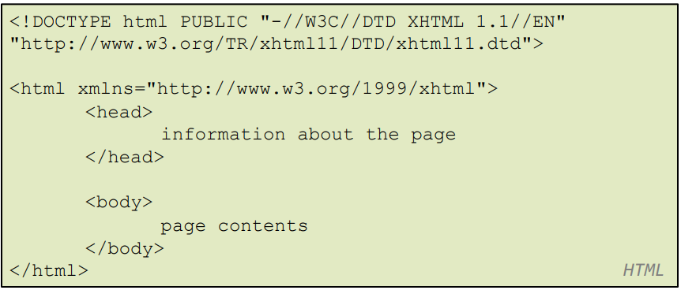
Structure of XHTML page
HTML is saved with extension .html
Basic structure: tags that enclose content, i.e., elements
Header describes the page
Body contains the page’s contents

Slide 7

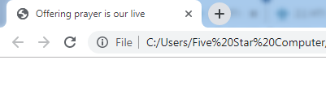
Page Title <title>
Placed within the head of the page
Displayed in web browser’s title mark and when bookmarking the page

Slide 8

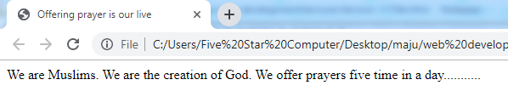
Paragraph <p>
Placed within the body of the page
HTML
Output

Slide 9
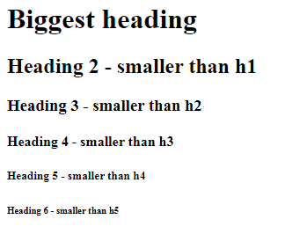
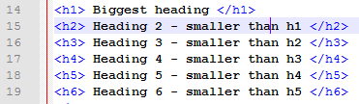
Headings <h1>,<h2>,……,<h6>
Used for writing heading.
6 different sizes of heading available in html.

Slide 10
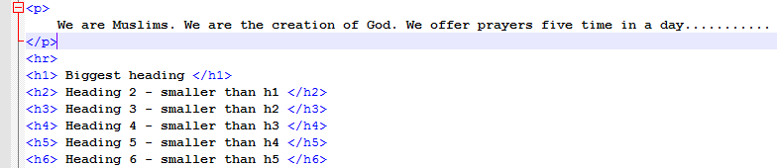
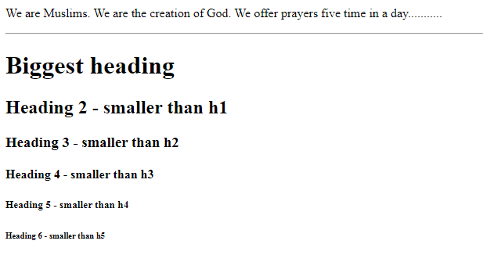
Horizontal rule <hr>

Slide 11
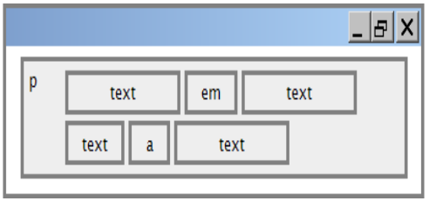
Block and Inline Statements
Block elements contain an entire large region of content.
examples: paragraphs, lists, table cells
the browser places a margin of whitespace between block elements for separation

Slide 12
Block and Inline Statements (cont.)
Inline elements affect a small amount of content
examples: bold text, code fragments, images
the browser allows many inline elements to appear on the same line

Slide 13
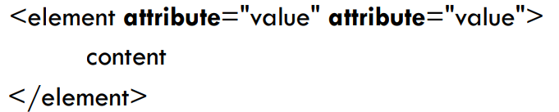
More HTML tags
Some tags can contain additional information called attributes
syntax:
example: <a href=“[page name]”>Next Page </a>

Slide 14
More HTML tags
Some tags don't contain content; can be opened and closed in one tag
Syntax:
Example: <hr/>
Example <img src = “” alt=“” />

Slide 15
Links <a>
The href attribute specifies the destination URL
Links or anchors are inline elements, so they must be placed inside a block element such as a p or h1

Slide 16
More about anchors
Types of URLs that can appear in anchors:
Absolute: to another web site(href=“google.com)
Relative: to another page on this web site(href=“./home.html”)

Slide 17
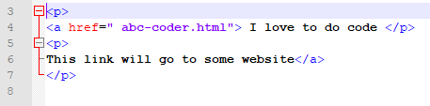
Nesting tags
Bad Nesting
Tags must be correctly nested: a closing tag must match the most recently opened tag
The browser may render it correctly anyway, but it is invalid XHTML

Slide 18

Images <img>
The src attribute specifies source of the image URL
XHTML also requires an alt attribute describing the image

Slide 19

More about images
If placed inside an anchor, the image will become a link
The title attribute specifies an optional tooltip

Slide 20
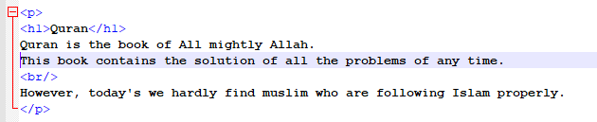
Line Break <br/>
br should be immediately closed with />
br should not be used to separate paragraphs or used multiple times in a row to create spacing

Slide 21
Comments <!-- -- >
Comments are useful for disabling sections of a page
Comments cannot be nested

Slide 22


Phrase elements
em: emphasized text (usually in italic)
strong: strongly emphasized text (usually in bold)
The tags must be properly nested for a valid page

Slide 23
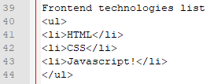
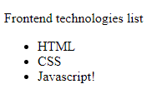
Unordered list <ul> <li>
ul represents a unordered list of items (block)
li represents a listed item within the list (block)

Slide 24
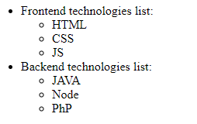
More about <ul> <li>
What should be html code of the following representation:

Slide 25
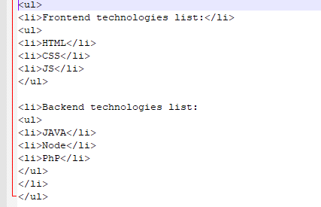
Common Error: Improper nested list placement
closing the outer li too early (or not at all) will render correctly in most browsers, but it is incorrect XHTML

Slide 26
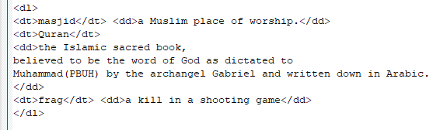
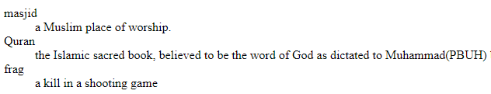
Definition list
dl represents a list of definitions of terms
dt represents each term, and dd its definition

Slide 27
Tables
table defines the overall table, with
tr defining each row
td defining each cell's data
th cells in a row are considered headers
a caption at the start of the table labels its meaning

Slide 28


Computer code <code>
code: a short section of computer code

Slide 29
Preformatted Text <pre>
Displayed with exactly the whitespace / line breaks given in the text
Shown in a fixed-width font by default

Slide 30
Web Standards

Slide 31
Web Standards
Why use XHTML and web standards?
more interoperable across different web browsers
more likely that our pages will display correctly in the future (compatibility)
can be interchanged with other XML data: SVG

Slide 32
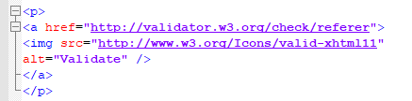

W3C XHTML Validator
checks your HTML code to make sure it meets the official strict XHTML specifications

Slide 33
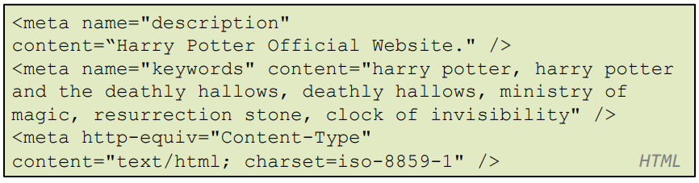
Web page meta data <meta>
information about your page (for a browser, search engine, etc.)
placed in the head of your XHTML page
meta tags often have both the name and content attributes

